Slide 1
Inquiry Investigation
Mr. C Janzen

Slide 2
Topic Chosen:
Heart disease
Inquiry Question:
How can the impact of heart disease be reduced in the circulatory system?

Slide 3
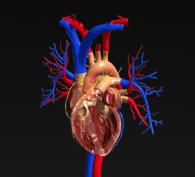
Investigative evidence – Article a
“In human beings, the circulatory system is a group of organs that moves a variety of substances to and from the body's cells. It is also frequently called the cardiovascular system, from the Greek word kardia, meaning "heart," and the Latin vasculum, meaning "small vessel." The basic components of the cardiovascular system are the heart, the blood vessels, and the blood. This system does an astonishing amount of work in the body. Each year, the heart pumps more than 2000 gal (7000 L) of blood through a closed system made up of approximately 60,000 mi (100,000 km) of blood vessels”.
"Circulatory system." World of Anatomy and Physiology, Gale, 2002. Interactive Science, https://link.gale.com/apps/doc/97/ISSCI?u=35wgss&sid=ISSCI&xid=13fe5859. Accessed 10 Dec. 2020.
I find this interesting because it shows me how the heart works, and I can see how blood flow through the heart can be restricted by clogging.
The heart has four main chambers with valves sealing each. This picture shows how blood flows through the heart.

